Slide 1

Mid-Tier Advocacy Business Focused Webinar
July 22, 2020
Rapid Business Transformation
Becoming Agile and Secure Now
The Clock is Ticking…
How to Accelerate Your CMMC Compliance Efforts

Slide 2


Welcome
Moderator: TONYA M. SAUNDERS, Principal of Washington Premier Group and Chairperson of the Board of Mid-Tier Advocacy.
Ms. Saunders has over 20 years in government affairs to include federal procurement, founding both Washington Premier Group, a Government Affairs firm and Mid-Tier Advocacy, a 501(c)3 nonprofit and nonpartisan organization.
About:
Mid-Tier Advocacy, Inc. (MTA) was established to work towards the elimination of the competitive disadvantage facing small emerging and mid-tier government support services companies.
MTA works to increase awareness of the challenges facing these businesses; we leverage our collective voice as an organization to promote federal policies that support healthy competition as well as long-term growth and sustainability.
DISCLAIMER: The following slides are deemed for informational purposes.

Slide 3
ARE YOU CMMC READY?
DOD is planning to migrate to the new CMMC framework in order to assess and enhance the cybersecurity posture of the Defense Industrial Base (DIB). The CMMC is intended to serve as a verification mechanism to ensure appropriate levels of cybersecurity practices and processes are in place to ensure basic cyber hygiene as well as protect controlled unclassified information (CUI) that resides on the Department’s industry partners’ networks.

Slide 4
RAPID BUSINESS TRANSFORMATION
What should your System Security Plan (SSP) include?
How can you implement the requirements in a way that enables CMMC validation?
Don’t delay any longer, CMMC is coming

Slide 5

CERTIFICATION
What is CMMC?
CMMC stands for “Cybersecurity Maturity Model Certification”. The CMMC will encompass multiple maturity levels that ranges from “Basic Cybersecurity Hygiene” to “Advanced/Progressive”. The intent is to incorporate CMMC into Defense Federal Acquisition Regulation Supplement (DFARS) and use it as a requirement for contract award.
Who Is Impacted?
All contractors doing business with the US Department of Defense. CMMC will affect DOD and its supply chain in many ways. Three of its most significant impacts will be on cost, conflicts and competition.

Slide 6



RON LEWIS
JON WILLIAMS
ARMANDO SEAY
MEET OUR PANELISTS

Slide 7


USE OF TECHNOLOGY
Ron Lewis, Founder and CEO
Founder and CEO of AtWork Systems which recently released an innovative SaaS platform to help small and medium sized companies solve business continuity challenges.
Software architect, C-level corporate executive, and entrepreneur with over two decades delivering technology solutions.
Previously served as a CTO and CIO for a large company.
B.S., cum laude, in Engineering from Boston University and M.S., honors, in Engineering from Columbia University.
For more details visit: www.atworksys.com
Contact: ron.lewis@atworksys.com

Slide 8
The Cyber Security Threat is Real … here’s what our leaders are saying
The loss of industrial information and intellectual property through cyber espionage
constitutes the “greatest transfer of wealth in history,” the nation’s top cyber warrior
Gen. Keith Alexander said. – 2012
"The warning signs are there. The system is blinking. It is why I believe we are at a
critical point," [DNI] Coats said, …. “Today, the digital infrastructure that serves this
country is literally under attack," he said.” – 2018
“Our adversaries are working hard every day to exfiltrate, hack, and breach our supply chain.
CMMC is about creating critical thinking skills for Cybersecurity, and not another checklist. I
don’t want to lose a single supplier. Still, the culture of the DoD has changed, and cyber best
practices are now mandatory,” Katie Arrington, CISO for Assistant Secretary for Defense
Acquisition
The warning signs are there
Ron Lewis – AtWork Systems

Slide 9
How does CMMC address the Cyber Threat?
Common set of security controls (policies, procedures and practices)
110 controls are divided up amongst 14 families –
  Access Control, Identification & Authentication, Audit & Accountability, etc
Organized like the CMMI in levels to provide flexibility to programs
Security controls and practices … defined in NIST 800-171
Controlled Unclassified Information
introduced by Executive Order in 2010 to consolidate the various unclassified markings (FOUO, SBU, LES, etc.)
Policies, Procedures & Practices
Ron Lewis – AtWork Systems

Slide 10
How Well are You Prepared for the Challenge?
Increased vulnerabilities and attacks
Lack of expertise and resources
High cost to assess, implement, and maintain
Increased virtual workforce
CMMC requirements
Our Recommendation to Leaders of SMBs
Find a trusted advisor and security service partner
Adopt strategic Cloud solutions
Start now and turn CMMC into your competitive advantage
Examine
Your Risks
Ron Lewis – AtWork Systems

Slide 11
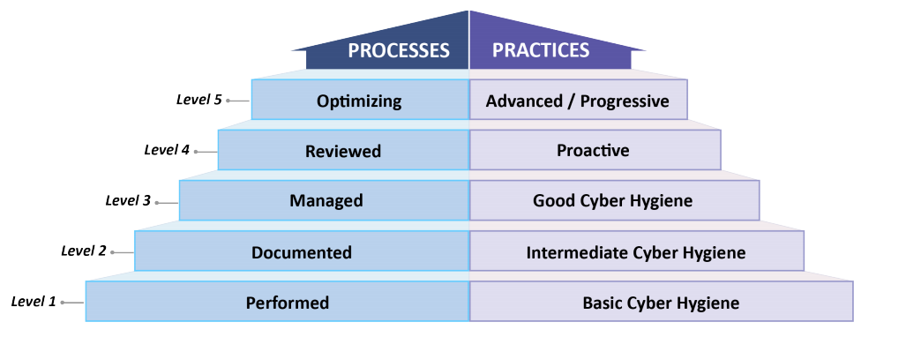
What is CMMC Certification?
Understanding the certification levels and what’s needed?
CMMC Levels 1-5
Ron Lewis – AtWork Systems
CMMC Certification Levels - Referenced from https://www.acq.osd.mil/cmmc/docs/CMMC_ModelMain_V1.02_20200318.pdf

Slide 12
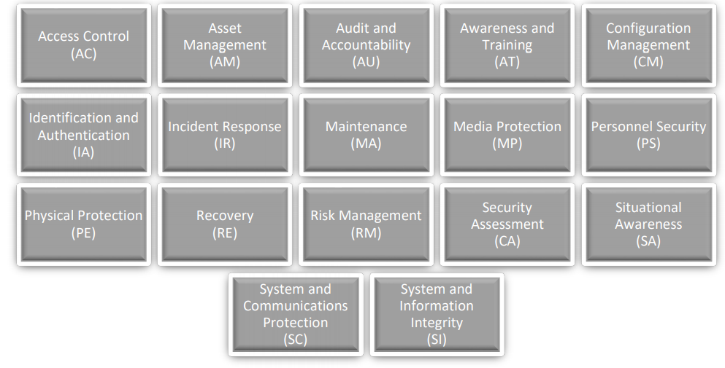
Understanding the 17 CMMC domains
17 CMMC Domains
Ron Lewis – AtWork Systems
CMMC Domains - Reference: https://www.acq.osd.mil/cmmc/docs/CMMC_ModelMain_V1.02_20200318.pdf

Slide 13
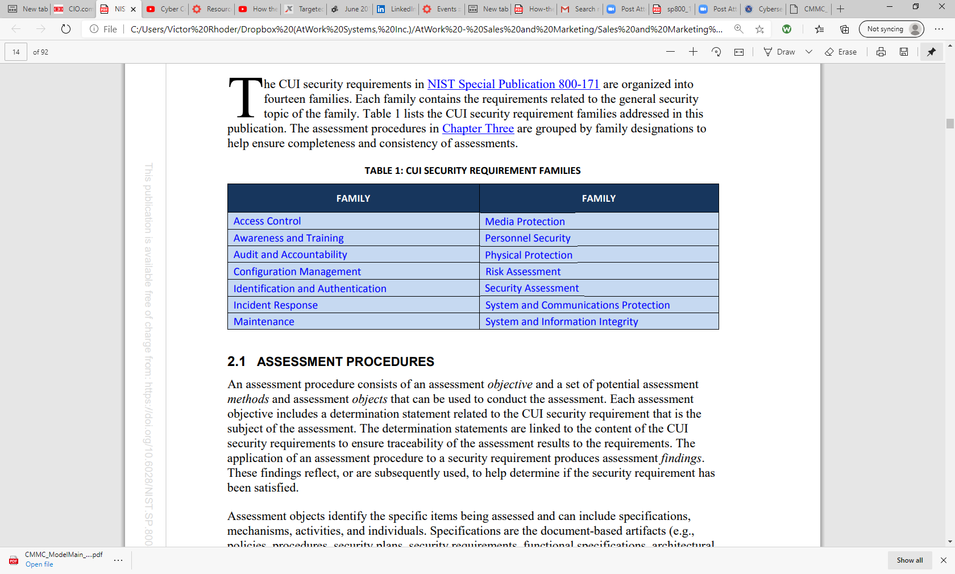
What’s required?
Illustration of one the controls reviewed during certification
Concepts for Assessments of CUI Security Requirements
The CUI security requirements in NIST Special Publication 800-171 are organized into fourteen families.
CMMC Certification Practice Area
3.4.7 Restrict, disable, and prevent the use of nonessential programs, functions, ports, protocols, and services. (table)
3.4.7 broken out in accordance with NIST SP 800-171A
3.4.7[a] essential programs are defined.
3.4.7[b] the use of nonessential programs is defined.
3.4.7[c] the use of nonessential programs is restricted, disabled, or prevented as defined.
3.4.7[d] essential functions are defined.
3.4.7[e] the use of nonessential functions is defined.
3.4.7[f] the use of nonessential functions is restricted, disabled, or prevented as defined.
3.4.7[g] essential ports are defined.
3.4.7[h] the use of nonessential ports is defined.
3.4.7[i] the use of nonessential ports is restricted, disabled, or prevented as defined.
3.4.7[j] essential protocols are defined.
3.4.7[k] the use of nonessential protocols is defined.
3.4.7[l] the use of nonessential protocols is restricted, disabled, or prevented as defined.
3.4.7[m] essential services are defined.
3.4.7[n] the use of nonessential services is defined.
3.4.7[o] the use of nonessential services is restricted, disabled, or prevented as defined
You Need to Know
Ron Lewis – AtWork Systems
Reference: https://nvlpubs.nist.gov/nistpubs/SpecialPublications/NIST.SP.800-171A.pdf

Slide 14
What can you do now to get better prepared for Certification?
Getting Started
Identify a trusted advisor
Implement NIST SP 800-171, then access your progress using 800-171A
It is the requirement
Going to get you most of the way to CMMC Level 3
The 20 additional controls aren’t too bad
You have likely stated you’re compliant already
Suggested Next Steps
If you don’t have MFA yet, at least turn it on for O365 (please)
Identify FCI/CUI in your environment
Companies with a mature implementation … assess against 800-171A
Document everything
Complex environments just getting started
Focus on CUI flow. Plan to segment. Multiple security domains?
Smaller businesses
Its tough. It ain’t fun. It can be done. Be patient with the process
Let’s Get Started Now
Ron Lewis – AtWork Systems

Slide 15
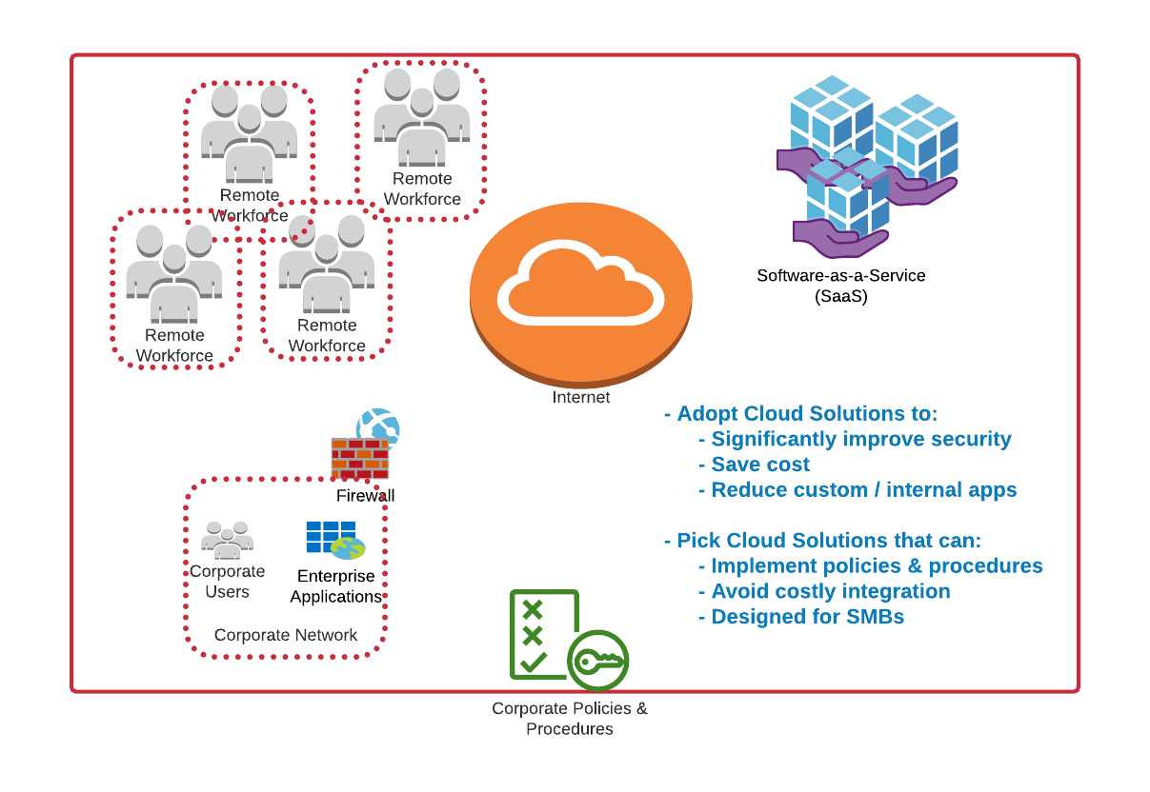
How can your investment & your infrastructure get you prepared?
Identify opportunities to leverage outside resources effectively
Identify your gaps and risks
  Infrastructure
  Expertise
  Processes
  Controls
Evaluate the benefits of using a SaaS platform
  Eliminate manual process control risks
  Transfer risks
  Leverage infrastructure best practices and expertise
  Minimize internal costs
  Accelerate compliance timeline
Identify shared roles and responsibilities
Consolidate as much as possible – a single provider is optimum
Invest In The Cloud
Ron Lewis – AtWork Systems

Slide 16
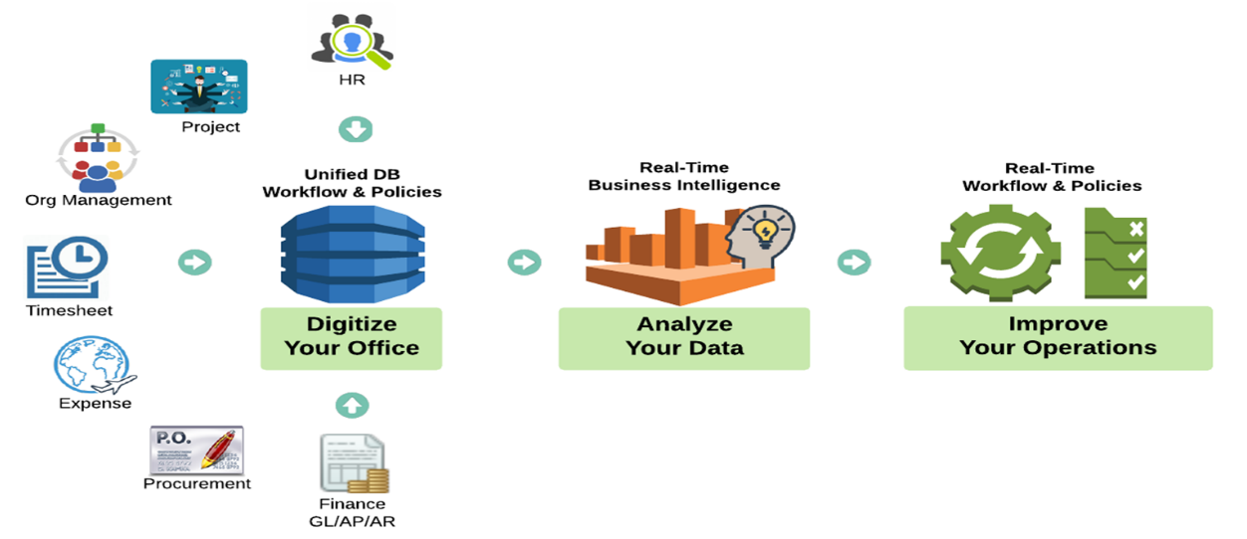
OneLynk’s Alignment with CMMC Requirements
Addresses current security compliance gaps experienced in the SMB community
Imbedded Security Features
Identity Management
Authentication – password policies, email verification, reCAPTCHA, one-time password, multifactor
Session management – various timeout settings including login, idle, refresh
Role, group, and user management
Single-sign-on
Data Encryption
All in-flight data encrypted via SSL
Data-at-rest encrypted using Amazon RDS (relational database service)
Industry Leading Secured Cloud Services - Amazon Web Service
Maintenance and Support
Segregation of duties, policies, and procedures
Ongoing test – vulnerability, penetration
Ongoing audit and remediation as required
OneLynk
OneLynk rapidly improves the security profile of SMB’s through an affordable NIST, DFAR and CMMC compliant digital business platform
Ron Lewis – AtWork Systems

Slide 17

Legal Advisor
Jon Williams
Partner at PilieroMazza
Jon has over 15 years of experience advising contractors on a wide range of government contracting matters and Federal Acquisition Regulation compliance, including the federal procurement programs for small businesses (i.e., the 8(a), HUBZone, WOSB, and SDVOSB programs). He represents contractors in bid protests, size protests and appeals, and related administrative and court proceedings. Mr. Williams assists large and small contractors in navigating SBA audits and investigations, including subcontracting plan compliance reviews, IG investigations, and suspension and debarment proceedings. He regularly helps contractors to establish teaming, subcontract, joint venture, and mentor-protégé relationships.
For more details visit: https://www.pilieromazza.com
Contact: Jon Williams, 202-857-1000 or jwilliams@pilieromazza.com

Slide 18
Why You Should Focus on Cybersecurity Now
Federal agencies are putting more emphasis on cybersecurity in evaluation and award decisions
Most federal contracts already include cybersecurity provisions
  FAR 52.204-21: Basic cyber safeguards (similar to CMMC Level 1)
  DFARS 252.204-7012: More extensive cybersecurity requirements, including compliance with NIST SP 800-171 (similar to CMMC Level 3)
Being out of compliance with the existing requirements creates protest risk, potential breach of contract and False Claims Act liability, and exposure to teaming partners
Now is the time to address your internal cyber policies and procedures, and your arrangements with third parties, to minimize risk, gain a competitive advantage, and prepare for CMMC

Slide 19
Flow Down to Subcontractors
Federal agencies are putting more emphasis on cybersecurity in evaluation and award decisions
DFARS 252.204-7012 must be flowed down to subcontractors, but only when subcontract performance is for “operationally critical support” or controlled unclassified information (“CUI”) is necessary for performance of the subcontract
  Operationally critical support is essential to mobilization, deployment, or sustainment of the Armed Forces in a contingency operation
Contractor may consult with the CO if uncertain about whether to flow down the clause to subcontractors
CMMC applies to subcontractors, but primes may flow down a different level requirement to subs
  So, the fact that a prime contract requires Level 4 certification does not necessarily mean the subcontract should also require Level 4

Slide 20
When Will You Need CMMC?
Federal agencies are putting more emphasis on cybersecurity in evaluation and award decisions
DoD is taking a “crawl, walk, run” approach in rolling out CMMC on new contracts
When the time comes, DoD estimates more than 50% of contractors will only need Level 1
Latest timeline:
  FY21-FY25: “Phased Rollout” starts in 2021 with a small number of contracts that require CMMC, increasing each year
  FY26: CMMC required for all DoD contracts
  Fall/winter 2020: Third-party certifiers can be certified
  Winter/spring 2021: Contractors can apply for CMMC
DoD is currently recommending that firms should plan to apply for CMMC at least 6 months before you need it

Slide 21
Certified Subject Matter Expert
Armando Seay
Member Board of Directors Maryland Innovation & Security Institute
Armando is an experienced CISO/FSO and DoD-cleared executive with years of IT, Program Management and business strategy experience. He is currently leading the charge in the development of a cyber security services and solutions vertical market. His previous experience includes, Program Manager IoT/SCADA/ICS Cyber Vulnerability and Compliance for DoD manufacturer industrial base, Google & AWS Elasticsearch analytic and visualization for consumer use of digital media over wireless carrier networks, Unity 3D cyber interactive threat visualization, CA Clarity implementations for DoD & Intel, Data center configuration management, and cyber threat SOC operations center.
For more details visit: https://misi.tech
Contact: aseay@misi.tech

Slide 22








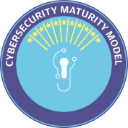








NIST Special Publication 800-171A
CYBERSECURITY MATURITY MODEL CERTIFICATION (CMMC)
Version 1.02 | March 18, 2020

Slide 23

CONTACT US: MID-TIER ADVOCACY
700 13th Street NW, 2nd Floor Washington, DC. 20005
(202) 421-5100
membership@midtier.org

