Slide 1

Teleworking in a COVID-19 Environment: What you Need to Know Now
Nichole D. Atallah, Esq.
Labor & Employment Law
PCI · 1725 I Street NW, Suite 100 · Washington, DC 20006 · (202) 775-7240

Slide 2
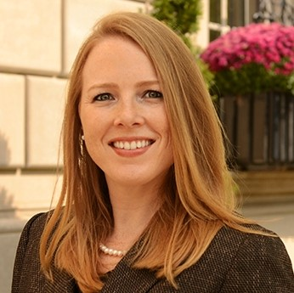
Your Instructor
Nichole D. Atallah, Esq. Labor & Employment Law PilieroMazza PLLC 888 17th St., 11th Floor Washington, DC 20006 natallah@pilieromazza.com www.pilieromazza.com (202) 857-1000

Slide 3
Employer Considerations in Allowing Telework
OMB Guidance Urging Agency Flexibility for Contractors
Be Flexible and Think More Broadly
Communicate with the Contracting Officer
Equipping Employees

Slide 4
Changes to Existing Policies
Special Guidelines for Unique Circumstances
Flexible Schedules for Parents and Caretakers
When Employees are Ill
Having a Written Policy

Slide 5
The Policy
Positions eligible
Requests
Return to work information
Data protection
Reporting structure
Policy compliance and deliverable expectations
Notification of illness

Slide 6
Legal Considerations and Risks
Wage and Hour Concerns
Discrimination and Disparate Treatment
Worker Compensation
ADA, FMLA, Sick Leave
Data Privacy

Slide 7
Keeping the Team Together
Communication is key
Finding ways to connect to the team
Consider a “buddy” system

Slide 8
QUESTIONS?

